Slide 1

CV DEVELOPES
THIRD YEAR CSE. GUIDE.
S.T.ABISHEAK ,950020104704. DR.FAREENA
D.RAGHUVARAN,950020104032. ASSISTANT PROFESSOR
CSE DEPARTMENT
ANNA UNIVERSITY REGIONAL CAMPUS -TIRUNELVELI

Slide 2
INTRODUCTION
MAKING RESUME GENERATION SIMPLER
HIGH SECURITY OF DATA STORAGE AND UPDATION OF DATA
HAVING VARIOUS FONTS AND TEMPLATE FOR RESUME GENERATION
TO REDUCE THE WRITTEN WORK AND REDUCE HARDCOPY
TO AVOID THE MISSING OF RESUME DOCUMENT

Slide 3
OBJECTIVE
LESS TIME CONSUME
EASY TO MAKE THE RESUME COLORFUL
TO MAKE A COMPLETE RESUME WITH THE PHOTO
DOWNLOAD EASY IN MANNER

Slide 4
ABSTRACT
IT HAS A MANDATORY STATUS AND DETAILS WANT TO BE FILL IN THE RESUME
IT HAS A OPTION TO TAKE A RESUME WITH PHOTO
IT HAS A EASY WAY TO TAKE YOUR RESUME BY GIVING USERNAME AND PASSWORD

Slide 5
LITERATURE SURVEY
"Resume Parsing and Matching Using Natural Language Processing" by A. Paranjpe and R. Kulkarni. This paper proposes an algorithm for extracting key information from resumes using natural language processing techniques and then matching it with job descriptions.
"Automated Resume Scoring Using Machine Learning" by R. Jain and S. Singh. This paper presents a machine learning-based approach for automatically scoring resumes based on their relevance to a given job description.
"Intelligent Resume Screening and Shortlisting Using Machine Learning" by S. Dutta and A. Bhattacharyya. This paper proposes a machine learning-based system for automatically screening and shortlisting resumes based on job requirements.
"Resume Ranking Using Machine Learning" by V. Narayanan and S. D. Raje. This paper presents a machine learning-based approach for ranking resumes based on their relevance to a given job description.

Slide 6
SYSTEM REQUIREMENTS
HARDWARE
INTEL I3 /AMD RYZEN 3 PROCESSOR
2GB RAM
SOFTWARE
LINUX
WINDOWS
MAC OS
CHROME OS

Slide 7
SYSTEM DESIGN
UML DIAGRAM

Slide 8
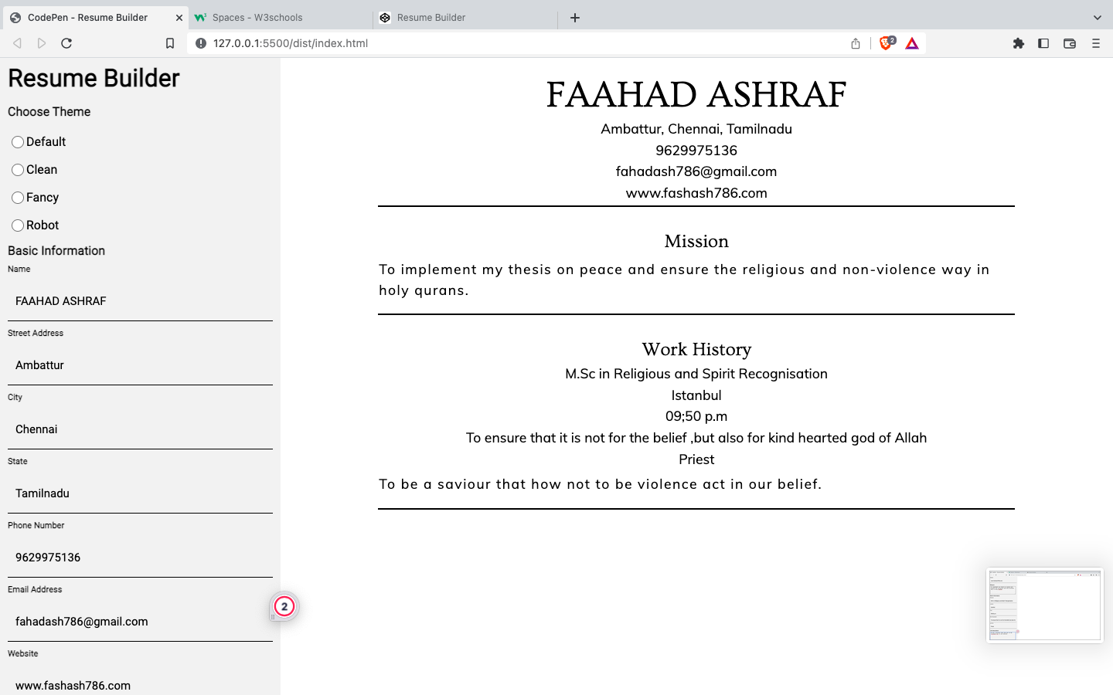
MODULE DESCRIPTION 1
CREATION OF CV BUILDER
FIRST WE HAVE BUILT A ONLINE RESUME BUILDER USING HTML,CSS AND JAVASCRIPT.
WE HAVE CREATED FOUR THEMES WITH DIFFERENT FONTS .
ALONG WITH THAT WE HAVE MENTION A MANDATORY FORM FOR FILLUP DETAILS .

Slide 9
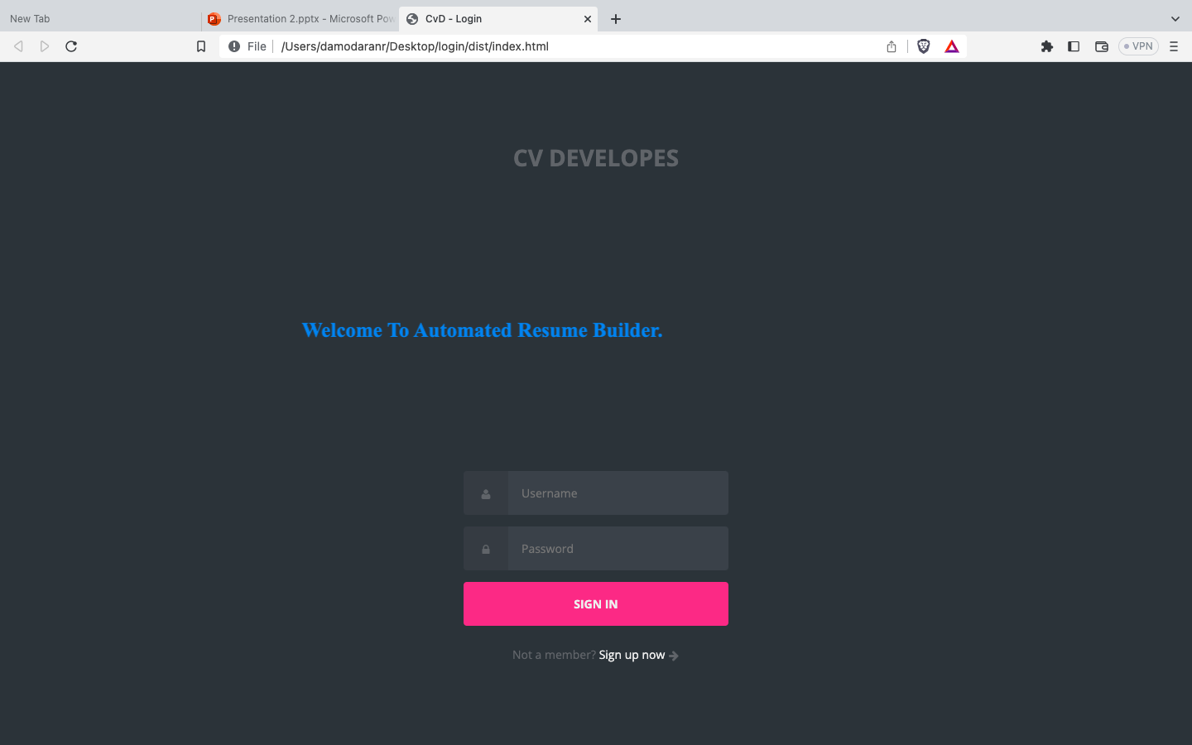
MODULE DESCRIPTION 2
CREATING A HOMEPAGE
WE HAD LOGIN PAGE WITH USERNAME AND PASSWORD.
ALONG WITH THAT WE HAVE AUTHENTICATION SYSTEM TO GET THE USER TO BE SECURED WE ARE GETTING OTP FOR USER SECURITY.

Slide 10
MODULE DESCRIPTION 3
CHOOSING THEMES AND COLLECT THE FILE
WE ARE HAVING HOMEPAGE WITH VARIOUS CV BUILDER THEME AND BUILDER WILL BE CONNECTED.
ALONG WITH THAT WE HAVE FIREBASE SYSTEM TO GET THE USER DATA COLLECTED AND WE ARE DOWNLOADING A FILE USING BLOB.

Slide 11
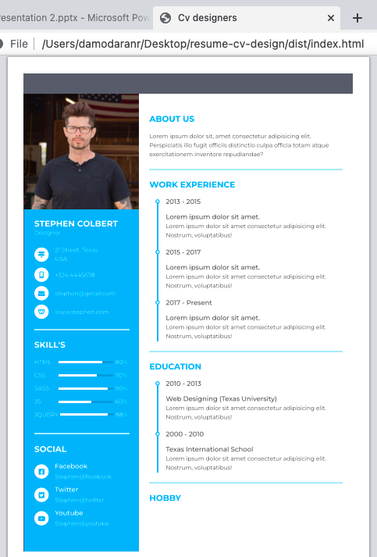
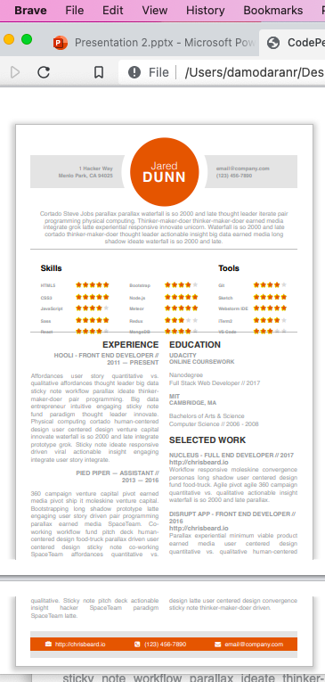
40% PROJECT COMPLETION
THE ABOVE IMAGE IS THE HOMEPAGE OF OUR WEBSITE.
THE BELOW ONE IS THE CV BUILDER.
WE HAD DIFFERENT TEMPLATES.

Slide 12
SUMMARY
This resume is for the college freshers,business personalities and time consumers.
First we have the authentication for the websites and then we have different types of themes.
We have a home page for different themes and we have different fonts.
Finally, we can download the file using the BLOB in js.

Slide 13
References
We have referred this website from Github.
We have get referred in other websites such as Canvas,Wix and onlinecvresume.com
Tutorialpoint website
W3school website
Wppathfinder and Developer Filip in youtube channels.

